Slide 1

Decision Tree

Slide 2
Class Plan
Lecture + Practical (1.5hours)
15mins break
Exercise (1.5hours)
15mins break
Presentation and Discussion (0.5 hours)
Week 1,2 & 3 do not have presentation

Slide 3
Objective
Why decision tree
How to choose the best tree
Solve overfit by pruning
Using Credit Card Example

Slide 4
Supervised Learning Classifier Machine Learning : Decision Tree

Slide 5
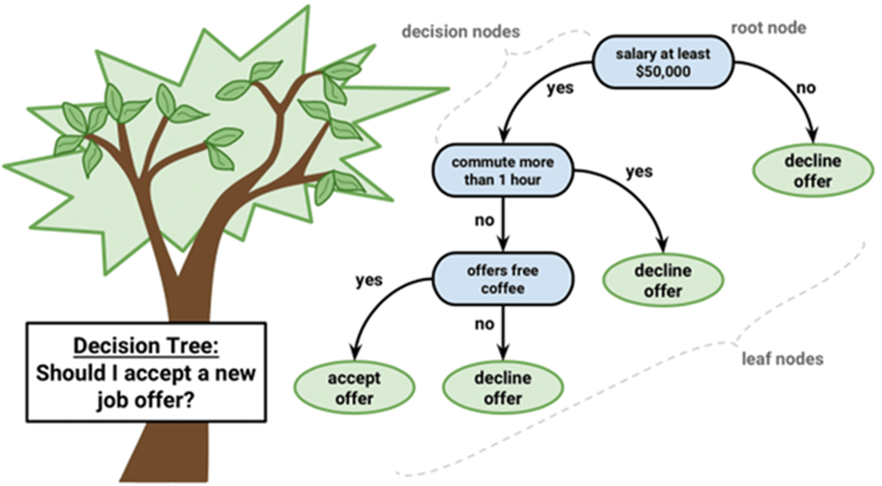
Decision Tree – Definition
A decision tree is a decision support tool that uses a tree-like model of decisions and their possible consequences, including chance event outcomes, resource costs, and utility.

Slide 6
Application
Operations research
Customer Relationship Management - How individuals access online services, providing recommendations
Detection of Fraudulent Financial Statements (FFS).

Slide 7
Decision Tree, CART, XGBoost
Decision Tree
Random Forest
CART Classification and Regression Trees
XGBoost - Extreme Gradient Boosting

Slide 8
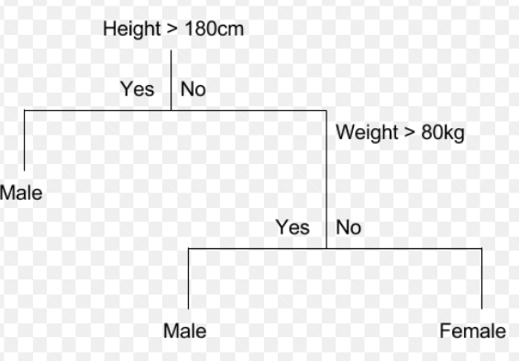
CART

Slide 9
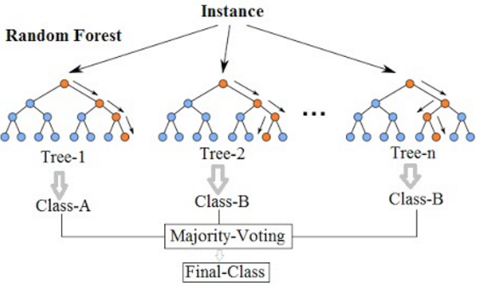
Random Forest

Slide 10
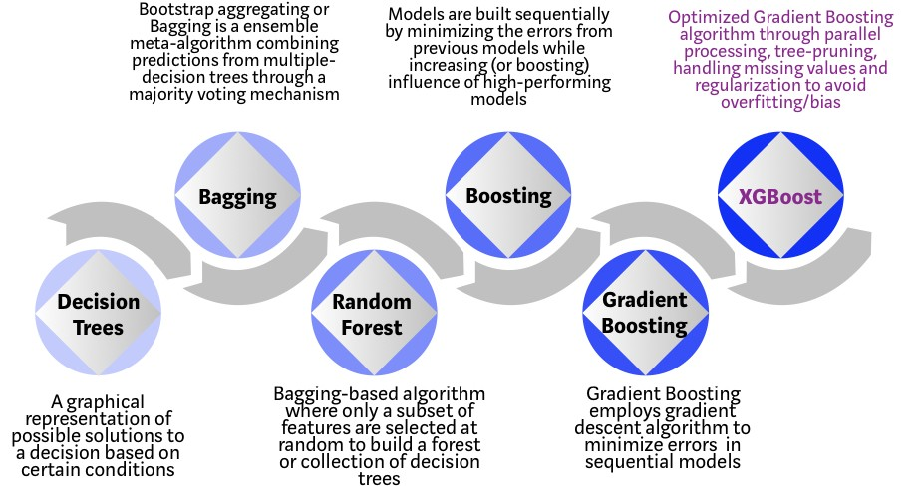
XGBoost
https://towardsdatascience.com/https-medium-com-vishalmorde-xgboost-algorithm-long-she-may-rein-edd9f99be63d

Slide 11
Activity
Create a small tree
Grow the tree
Prune the tree
Compare the results

Slide 12
Decision Tree
Classification and Regression Tree (CART)
Can be applied for either continuous or categorical Y.
Results and Interpretation [High explanability]
Phrase 1: Grow the Tree
Phrase 2: Prune the Tree
Selecting the “best” Tree

Slide 13
Decision Tree Using R - rpart
30 rows of data

Slide 14
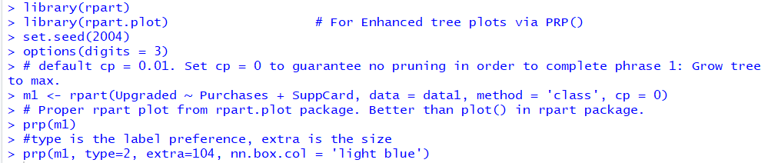
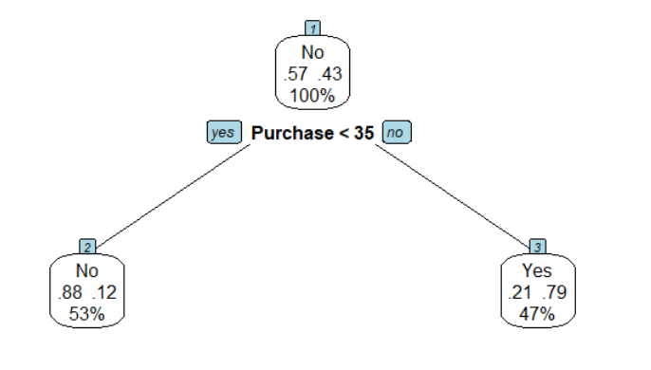
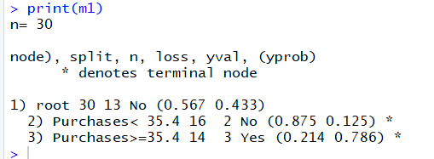
Activity 1: Decision Tree Using R - rpart
2/16=0.125
If the purchase is less than 35, the decision tree prediction is “No” Upgrade. There are 16 predictions (less than 35 purchase) in total and 14 predicted correctly (.88) and 2 Predicted wrongly (0.12)
30 rows of data

Slide 15

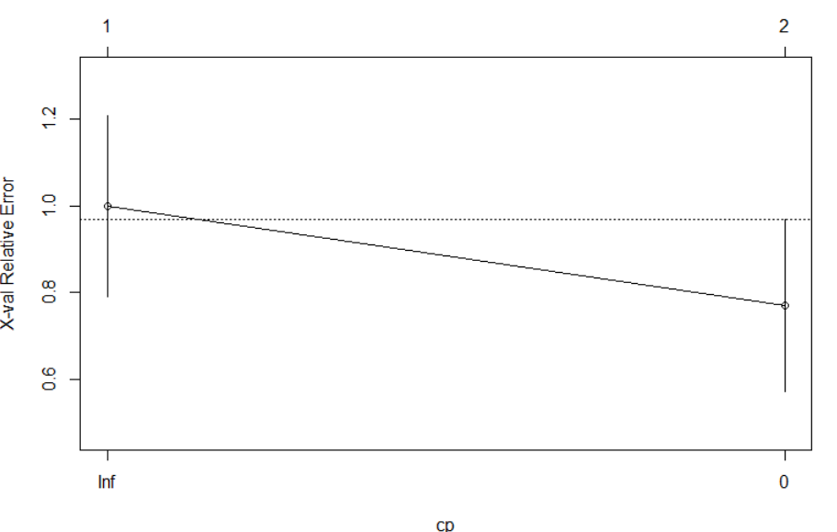
Should you Prune the tree? No if the error is dropping

Slide 16
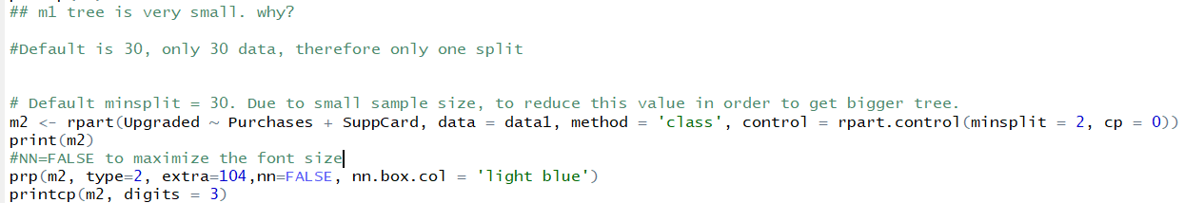
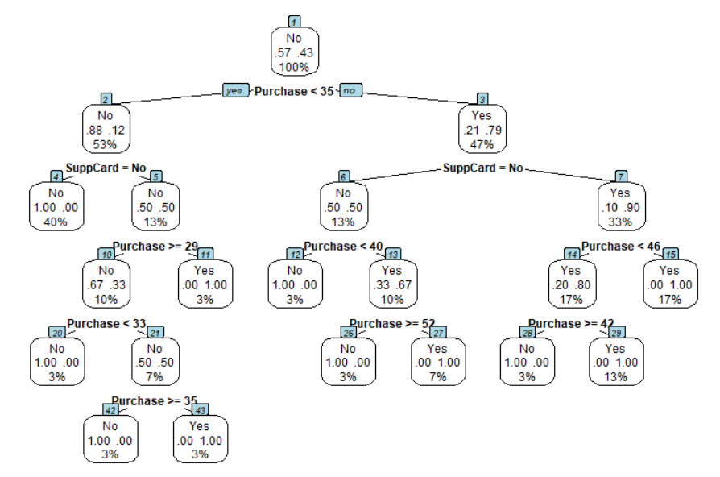
Activity 2: M2: Grow the Tree

Slide 17
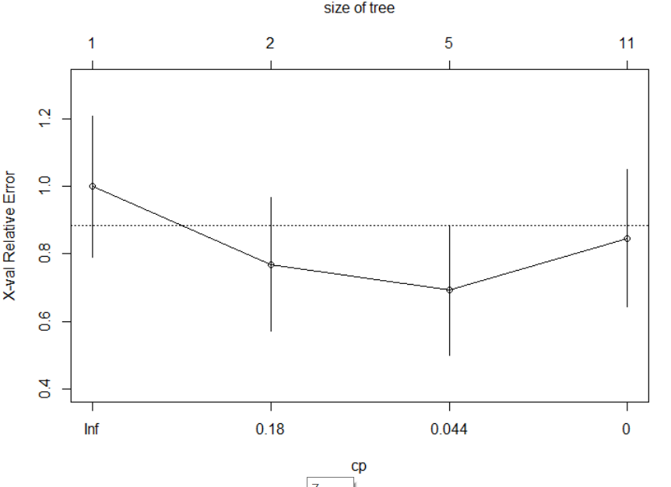
Prune The Tree for M2? Yes, error goes up after 0.044

Slide 18
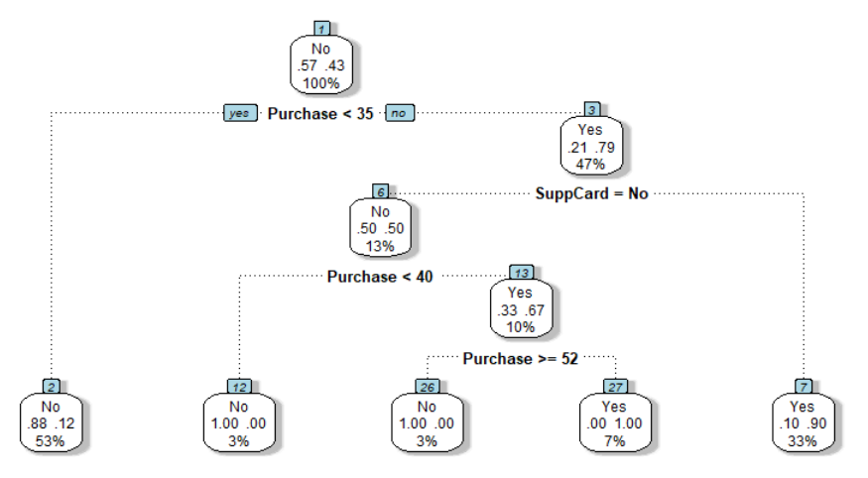
Activity 3: M3 Pruned the tree

Slide 19
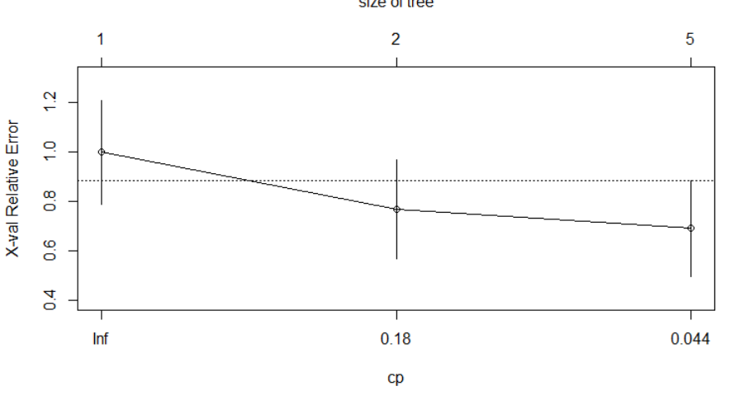
Prune The Tree for M3? No need to Prune, error did not go up

Slide 20

Feature Selection, Purchase more important than SuppCard

Slide 21
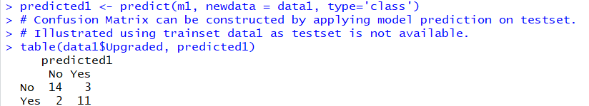
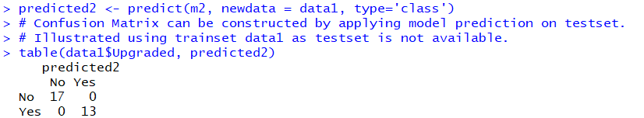
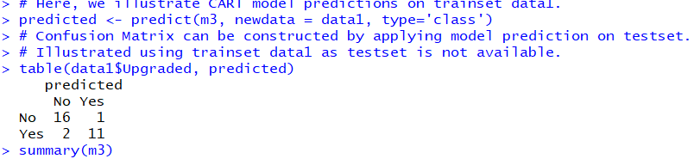
Activity 4 : Compare the final Results
Model 2 has zero error but model 3 has 3 error, which is better?

Slide 22
Activity 5 (15mins)
Write a paragraph of no more than 100 words on whether model 2 or model 3 is better and why. Is there anyway to improve our model and how.

Slide 23
Answer to Activity 5
Although model 2 has zero error, the tree is too big that we over train the dataset and cause overfitting problem. When we try to generalize the solution, the next dataset will most likely have error. Also, we only have 30 data which is consider a small set of data for machine learning. To overcome this problem, we can increase our data and split our data into training and testing data set and using cross validation or boot strapping to increase the generalization of our model.

Slide 24
Programming Activities (B)
Credit Card Default - Split Train Test Set

Slide 25
Presentation & Discussion (1)
Explain the similarity and difference in regression and decision tree
What are their strengths and weaknesses of regression and decision tree.

Slide 26
Presentation & Discussion (2)
Think of a project you would like to do (individual). Discuss.
Example of projects:
Analytics
Prediction
Automation:
Chatbot
RPA

Slide 27
Presentation & Discussion (3)
Form a Team, Think of a Name, think of a project you would like to do (Group).
Example of projects:
Analytics
Prediction
Automation:
Chatbot
RPA

Slide 28
Check Your Understanding
Create a small tree
Grow the tree (minsplit = 2)
Prune the tree – when to stop (when error goes up)
Analyze the results (confusion matrix)

